Slide 1
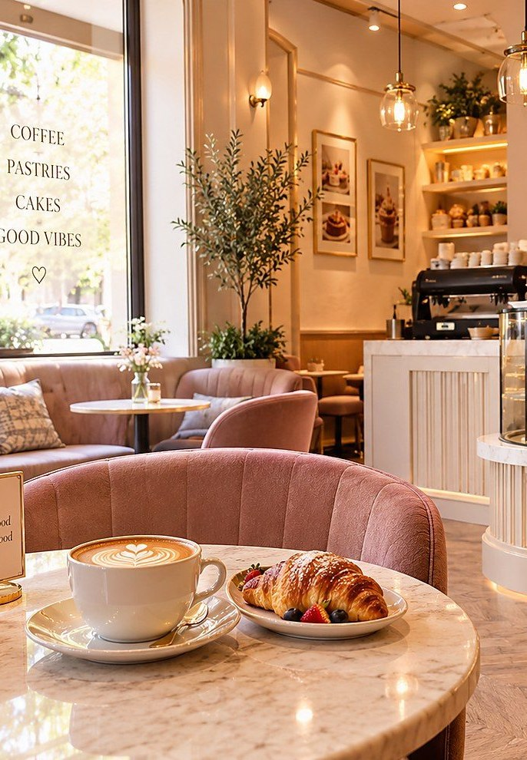

BAKERZ BITE
Artisan Bakery & Café
A Front-End Website Development Project
Group: A Course: CPISM
Batch code: 2606E2 APTECH NN 2
TEAM MEMBERS
Fariha Kamran Student1733422
Fatima Irfan Student1728977
Kashaf Baig Student1733423
Ahmed Faraz Siddiqui Student1733177
Notes:
Welcome. Bakerz Bite is our front-end project: a multi-page artisan bakery and café website built with HTML, CSS, JavaScript and a few supporting libraries. (Team names and batch are taken from the Developer Guide — edit if needed.)

Slide 2
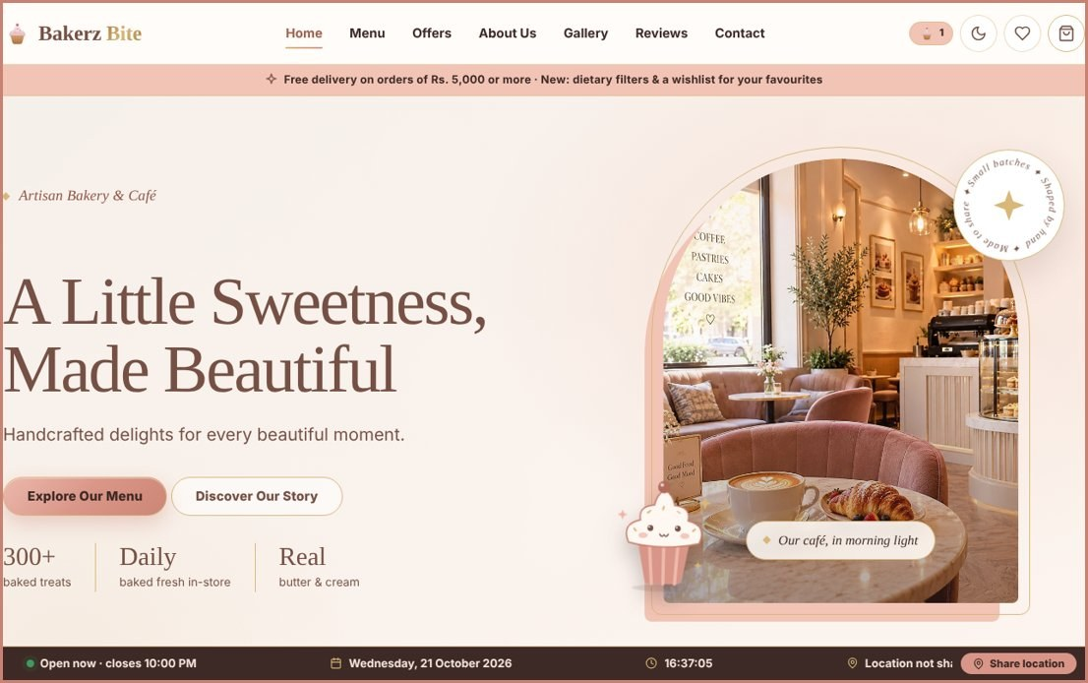
PROJECT OVERVIEW
A modern digital bakery experience
Bakerz Bite is a responsive multi-page website for a fictional artisan bakery & café in Lahore, Pakistan.
1
Purpose
Let visitors discover products, prices, ingredients and allergens — then personalise and order online.
2
Audience
Bakery and café customers browsing on mobile, tablet or desktop.
3
Objective
An attractive, user-friendly digital bakery experience built with core web technologies.
56
products
14
categories
26
pages
Notes:
Project overview, purpose, audience and objective. Figures (56 products, 14 categories, 26 pages) come from the Developer Guide.

Slide 3




PROBLEM STATEMENT
The problem we set out to solve
Small bakeries and cafés often lack a clear, modern online presence, so customers struggle to browse products, customise orders and understand prices before they buy.
Hard to discover
Hard to personalise
Unclear total cost
Not always available
Menus, prices, ingredients and allergens are scattered or missing, so people cannot decide before visiting.
Cakes need a size, frosting, flavour and message, which is hard to handle clearly over calls or chat.
Offers, delivery charges and the final total are not visible until late, which causes confusion.
Opening hours, location and ordering should work on any device, at any time of day.
Notes:
Problem statement. Explain why a bakery or café needs a modern online presence. These are the common pain points the Bakerz Bite website is designed to remove.

Slide 4
SOLUTION / CORE IDEA
One shared, data-driven website
Bakerz Bite turns a bakery’s whole catalogue into a fast, responsive website that runs entirely in the browser, with no back-end server or database.
Data files
data.js · JSON · XML
script.js builds each page
reads data-page, renders header, products and cart
1
Discover
56 products in 14 categories, with search, filters, diet options and a wishlist.
26 responsive HTML pages
index.html + 25 pages in /html
2
Personalise and order
Customise size, frosting and flavour with a live price, then use the cart and validated checkout.
Always consistent
One shared script and data files render all 26 pages, with dark mode and accessibility built in.
Browser storage
localStorage: cart, theme, wishlist, reviews
3
Notes:
Core idea: the whole catalogue lives in data files and one shared script builds every page in the browser, so no server is needed. Walk the three points on the left, then the data flow on the right.

Slide 5
PROJECT OBJECTIVES
What we set out to achieve
1
Responsive multi-page site
2
Clean separation
3
Working shop logic
Built with HTML5, CSS3 and JavaScript for mobile, tablet and desktop.
Content, presentation and behaviour are kept apart; data lives in JSON/JS files.
Cart, automatic offers and a validated checkout using localStorage.
4
Modern UI practices
5
Supporting technologies
6
Maintainable code
CSS variables, dark mode, animations, glass-style cards and accessibility.
Bootstrap, jQuery and XML/JSON integrated to show their use cases.
Clean, reusable code with one shared script for every page.
Notes:
Six objectives taken from the Developer Guide. Each one maps to a part of the finished website.

Slide 6
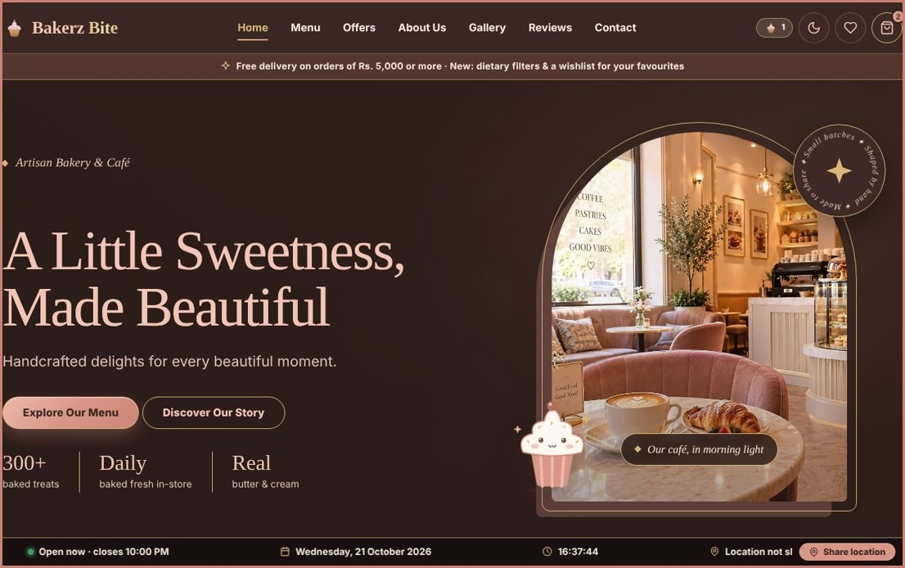
STYLE BOARD
Brand identity & UI/UX design
Aa
Headings — Fraunces
Warm, elegant serif for titles.
Body — Nunito
Friendly, highly readable sans-serif.
Logo · consistent nav on every page
Responsive layout
Light / dark theme
Cream
Peach
Dusty Peach
Google Fonts · loaded by the site
Accessible (ARIA, skip link)
Consistent navigation
Mocha
Espresso
Champagne
Notes:
The palette and fonts shown here are what the website actually uses (peach, mocha, espresso, champagne on cream; Fraunces + Nunito). The deck uses Cambria and Calibri so it renders on any PC.

Slide 7
HOMEPAGE
The homepage experience
2
1
Announcement bar
Free delivery from Rs. 5,000
1
2
Navigation
Home · Menu · Offers · About Us · Gallery · Reviews · Contact
3
4
Hero & CTA
“Explore Our Menu” / “Discover Our Story”
3
4
Hero imagery
Café scene with stats strip
5
Live ticker
Open/closed status, date & time, location
5
Also: welcome intro with city chooser, featured products and customer reviews.
Notes:
Real screenshot of our homepage. Walk through the numbered features. Welcome intro, city chooser (Karachi, Hyderabad, Lahore) exist in the code; show them live if you want to demo.

Slide 8
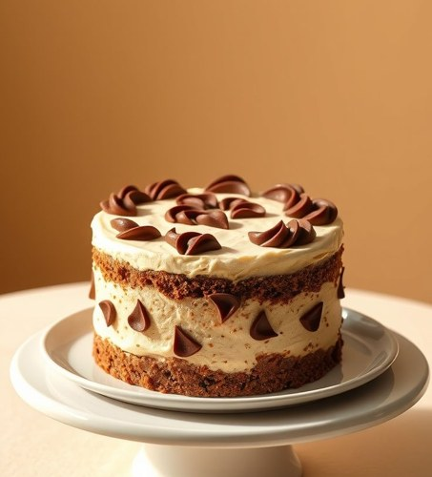

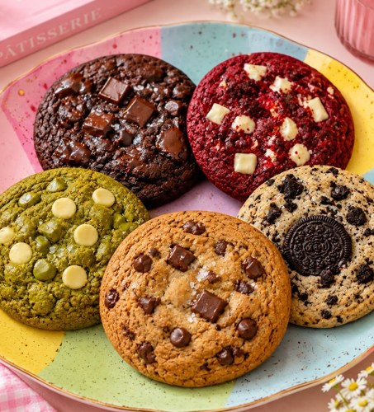
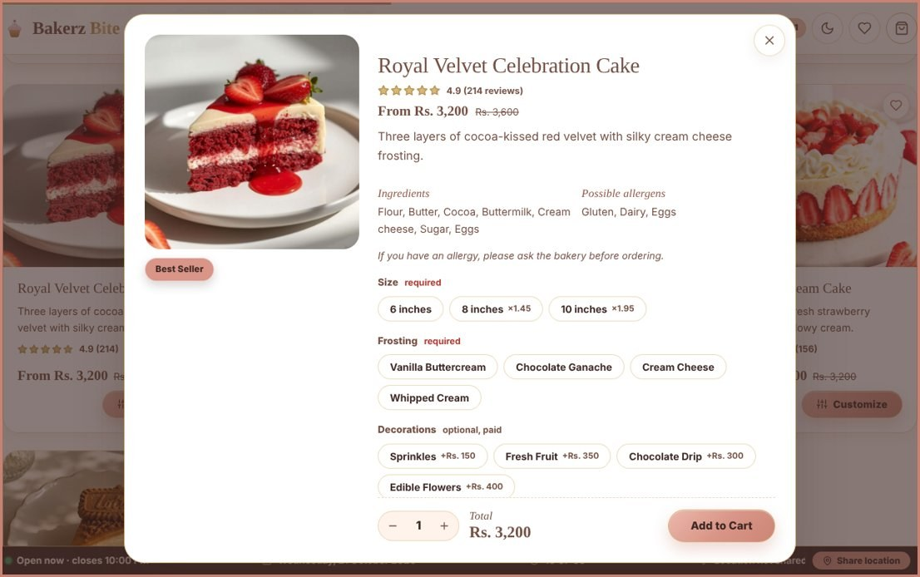
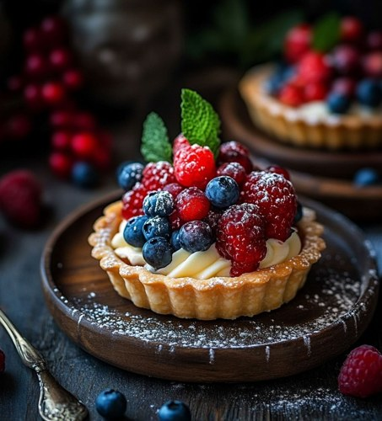
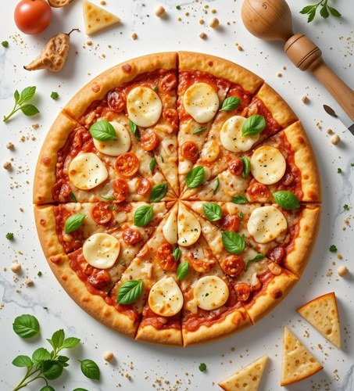

BROWSE
Menu & product discovery
Cakes
Pastries
Cookies
Search · sort · filter price, rating, diet & more
Pies & Tarts
Pizza
Coffee
Product details ingredients, allergens, add-ons
Badges Popular · Best Seller · New · Sale
+ 8 more categories: donuts, cupcakes, breads, tea, drinks…
Notes:
Menu page screenshot and product-details modal come from the real site. Product data (56 items) lives in data.js / products.json.

Slide 9
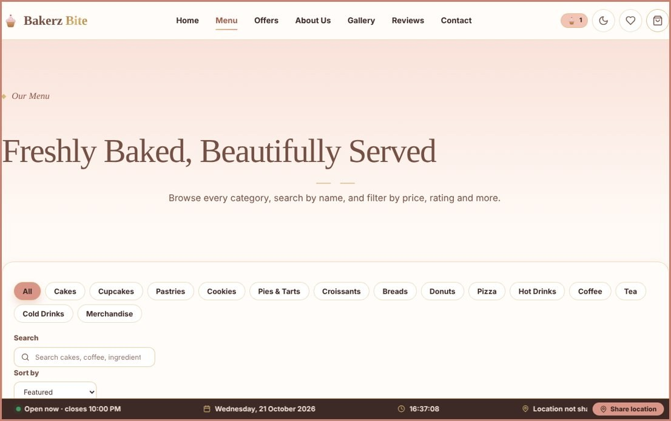
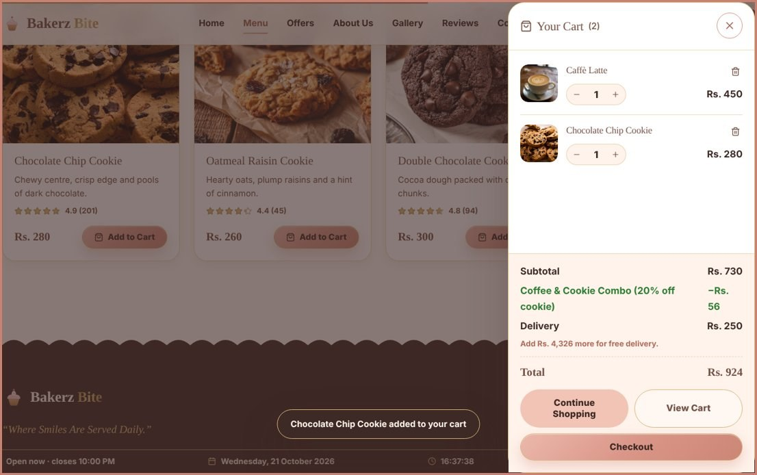
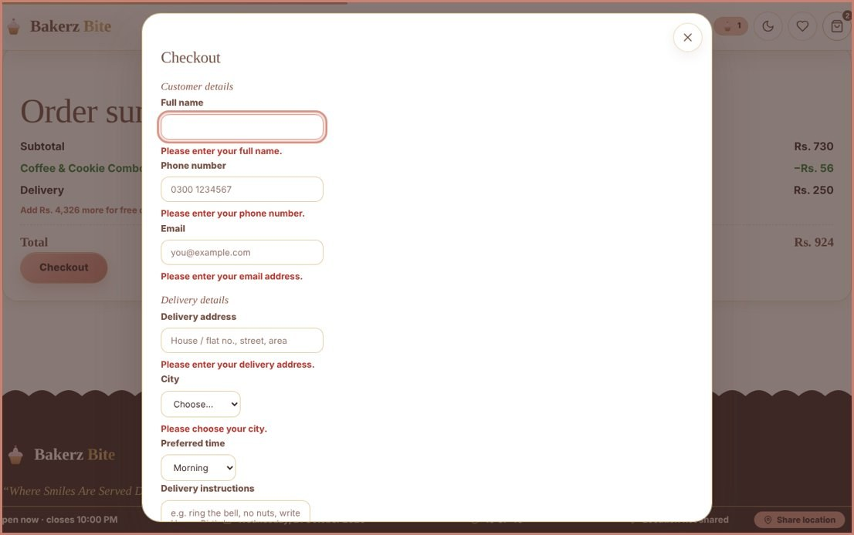
CUSTOMER JOURNEY
Interactive features & shopping experience
›
›
›
1
Browse
Search, filter and sort the menu
2
Customise
Size, frosting, flavour, toppings, cake message
3
Review cart
Quantities, offers, delivery & live totals
4
Checkout
Validated form · COD or card form
WORKING FEATURES
Cart + live counter
Wishlist
Light / dark theme
Automatic offers & combo deals
Free delivery from Rs. 5,000
Simulated on the client side: order confirmation (e.g. BB-1234) and the online-payment form — no real payment or order tracking.
Notes:
Walk the journey left to right using real screenshots. Be clear that checkout is simulated. Build-your-own-cake and recently-viewed are not in the submitted code, so they are intentionally not shown.

Slide 10
26 PAGES · ONE SHARED CODEBASE
Website structure & navigation
Home · index.html
Menu
Offers
Our Story
Gallery
Reviews
Contact
MENU → 14 CATEGORY PAGES
Cakes
Cupcakes
Pastries
Croissants
Donuts
Cookies
Breads
Pizza
Pies & Tarts
Coffee
Tea
Hot Drinks
Cold Drinks
Merchandise
ALSO
A single shared script reads each page’s data-page attribute, so every page behaves consistently and products stay easy to find.
FAQ
Cart
Privacy
Terms
Sitemap
Notes:
26 pages: index.html plus 25 files in /html — Menu, 14 categories, Offers, Our Story, Gallery, Reviews, Contact, FAQ, Cart, Privacy, Terms, Sitemap.

Slide 11
TECH STACK
Technologies & implementation
HTML5 Semantic structure, ARIA, data-* attributes
Browser
Client-side multi-page app
CSS3 Variables, Grid/Flexbox, dark mode, animations
HTML pages (26)
index.html + /html
Bootstrap 5.3.3 Responsive grid and utilities
JavaScript (vanilla) Rendering, cart, offers, filters, checkout
CSS + Bootstrap · script.js / premium.js
Presentation and behaviour
jQuery 3.7.1 Animated back-to-top button
Google Fonts Fraunces (headings) and Nunito (body)
Data files + localStorage
data.js · JSON · XML · Web Storage
JSON · XML · Web Storage Data files, XML catalogue, localStorage
Optional enhancement layer: jQuery · XML parser
Front-end only — no backend, database, login or real payment gateway
Notes:
Only technologies that are in the code are listed. jQuery and the XML catalogue are optional enhancements; the core site works without them.

Slide 12



CHALLENGES & PROBLEM SOLVING
Challenges & problem solving
What we check
Challenges & fixes
Skills gained
Navigation and links across all pages
Browsing, search and filters
Cart quantities and price totals
Theme and localStorage persistence
Layouts at mobile, tablet, desktop
26 consistent pages → one shared script + data-page
Cart across pages → localStorage
Options, offers, delivery → one totals() routine
No server → data in JS/JSON files
Responsive HTML/CSS/Bootstrap
DOM manipulation & state handling
Accessibility: ARIA, focus, reduced motion
Teamwork and technical documentation
Done with Chrome DevTools: Responsive mode, Console, Application tab
Notes:
Testing areas are listed as what we check, not as pass/fail results. Add real results here only if you actually ran them. Challenges are drawn from the project architecture.

Slide 13


BENEFITS & TARGET USERS
Who it helps and how
Target users
Benefits
Bakery and café customers browsing on mobile, tablet or desktop
Customers with dietary needs: egg-free, nut-free, dairy-free, gluten-free and vegan filters
People who place custom orders, such as celebration cakes
Users who rely on keyboard access, ARIA labels and reduced motion
The bakery team: a front end driven by easy-to-edit data files
Easy discovery: prices, ingredients and allergens in one place
Personalised orders with a live price before adding to the cart
Clear offers, delivery fee and totals, with free delivery from Rs. 5,000
Comfortable viewing with light and dark themes
Low running cost: no server or database needed
Notes:
Two columns: who the website is for, and what each group gains. Mention accessibility and dietary filters because they are real features in the code.

Slide 14








FUTURE SCOPE
Where Bakerz Bite can grow
Back end and database
User accounts
Real payments
Admin dashboard
Node.js/Express with MongoDB or MySQL for products, users and orders.
Registration, login, order history and saved addresses.
JazzCash, EasyPaisa, Stripe or PayPal, plus email/SMS confirmation.
Manage products, prices, offers, orders and reviews.
Order tracking
Coupons and loyalty
PWA and offline
More languages
Live status (received, baking, out for delivery) with maps.
Coupon codes, loyalty points and gift cards.
An installable app with offline mode using service workers.
English/Urdu support and multiple currencies.
Notes:
Eight realistic next steps from the Developer Guide. The current version is front-end only, so these all build on the existing structure.

Slide 15

CONCLUSION
What we delivered and learned
What we delivered
What we learned
A responsive, accessible 26-page bakery website
56 products, 14 categories, search, filters and a wishlist
Customisation with live price, automatic offers and a validated checkout
Light and dark themes; jQuery and XML added as enhancements
Structuring a multi-page project around one shared script
Building reusable components without a framework
Managing state in the browser with localStorage
Validating user input and documenting a project professionally
Front-end only today, and ready to grow with a back end, payments and an admin panel
Notes:
Wrap up: what was built, what the team learned, and that the structure is ready to grow. Then move to the thank-you slide and offer a live demo.

Slide 16
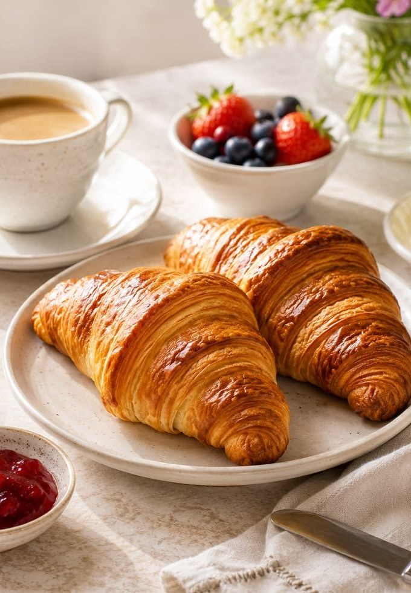
Thank You
Bakerz Bite — Where Smiles Are Served Daily
QUESTIONS & ANSWERS
Fariha Kamran · Fatima Irfan · Kashaf Baig · Ahmed Faraz Siddiqui
Group A · CPISM · Batch 2606E2
Notes:
Thank the teacher and invite questions. Offer to open the live website for a demo.

